Slide 1

Mathematical Functions, Characters, and Strings
TUIT
C++ Programming, Fall 2016
Lab #4
(II - part)

Slide 2
Read the lecture notes doing following tasks:
TUIT
Practice (II - part)
Hex to binary;
*Decimal to hex;
*Phone key pads;
Process two string;
Palindrome string;
*Random strings;
*Order three cities;
*Days of a month;
*Student major and status;
Financial application: payroll;
Check SSN

Slide 3
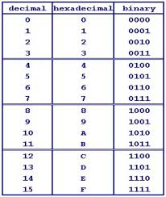


TUIT
1. Hex to binary
Write a program that prompts the user to enter a hex digit and displays its corresponding binary number.
Here is a sample runs:
Enter a hex digit: B The binary value is 1011
Enter a hex digit: G G is an invalid input

Slide 4
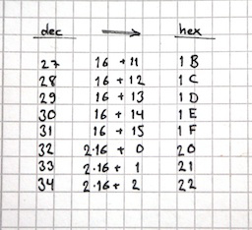
TUIT
2. *Decimal to hex
Write a program that prompts the user to enter an integer between 0 and 15 and displays its corresponding hex number.
Here are the sample runs:
Enter a decimal value (0 to 15): 11 The hex value is B
Enter a decimal value (0 to 15): 5 The hex value is 5
Enter a decimal value (0 to 15): 31 31 is an invalid input

Slide 5
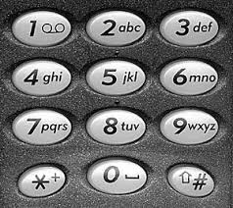
TUIT
3. *Phone key pads
The international standard letter/number mapping found on the telephone is shown below. Write a program that prompts the user to enter a letter and displays its corresponding number. Here is a sample runs:
Enter a letter: A The corresponding number is 2
Enter a letter: a The corresponding number is 2
Enter a letter: + + is an invalid input

Slide 6

TUIT
4. Process two string
Write a program that prompts the user to enter two strings and displays the length and the last character od each.
Here is a sample run:
Enter the first string: hello Enter the second string: world hello word’s length is 5 and last character is ‘o’. world word’s length is 5 and last character is ‘d’.

Slide 7
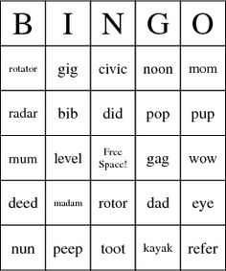
TUIT
5. Palindrome string
Write a program that prompts the user to enter a string with five lowercase letters and determines whether it is a palindrome.
Here are the sample runs:
Enter a five lowercase letters: level level is a palindrome!
Enter a five lowercase letters: books books is not a palindrome!

Slide 8
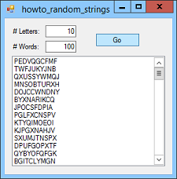
TUIT
6. *Random strings
Write a program that generates a random string with six lowercase letters.

Slide 9

TUIT
7. *Order three cities
Write a program that prompts the user to enter three cities and displays them in ascending order.
Here is a sample run:
Enter the first city: Tashkent Enter the second city: Samarkand Enter the third city: Urgench The three cities in alphabetical order are Samarkand Tashkent Urgench

Slide 10
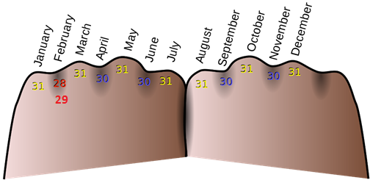
TUIT
8. *Days of a month
Write a program that prompts the user to enter the year and the first three letters of a month name (with the first letter in uppercase) and displays the number of days in the month.
Here is a sample run:
Enter a year: 2001 Enter a month: Jan Jan 2001 has 31 days
Enter a year: 2001 Enter a month: jan jan is not a correct month name

Slide 11
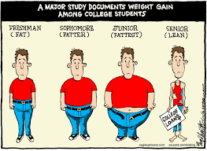
TUIT
9. *Student major and status
Write a program that prompts the user to enter two characters and displays the major and status represented in the characters. The first character indicates the major and second is number character 1, 2, 3, 4, which indicates whether a student is a freshman, sophomore, junior, or senior. Suppose the following characters are used to denote the major:
M: Mathematics
C: Computer Science
I: Information Technology
Here are the sample runs:
Enter two characters: M1 Mathematics Freshman
Enter two characters: C3 Computer Science Junior
Enter two characters: T3 Invalid major code
Enter two characters: M7 Invalid status code

Slide 12


TUIT
10. *Financial application: payroll
Write a program that reads the following information and print a payroll statement:
Employee’s name (e.g., Smith)
Number of hours worked in a week (e.g., 10)
Hourly pay rate (e.g., 9.75)
Federal tax withholding rate (e.g., 20%)
State tax withholding rate (e.g., 9%)
A sample run is shown below:
Enter employee’s name: Smith Enter number of hours worked in a week: 10 Enter hourly pay rate: 9.75 Enter federal tax withholding rate: 0.20 Enter state tax withholding rate: 0.09 Employee Name: Smith Hours Worked: 10.0 Pay Rate: $9.75 Gross Pay: $97.50 Deducations: Federal Withholding (20.0%): $19.5 State Withholding (9.0%): $8.77 Total Deducation: $28.27 Net Pay: $69.22

Slide 13
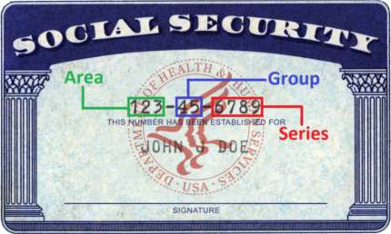
TUIT
11. *Check SSN
Write a program that prompts the user to enter a Social Security number in the format ddd-dd-dddd, where d is a digit.
Here are the sample runs:
Enter a SSN: 232-23-5435 232-23-5435 is a valid social security number
Enter a SSN: 23-23-5435 23-23-5435 is an invalid social security number

